Slide 1

Predictive Model Analysis
23-January-2023

Slide 2
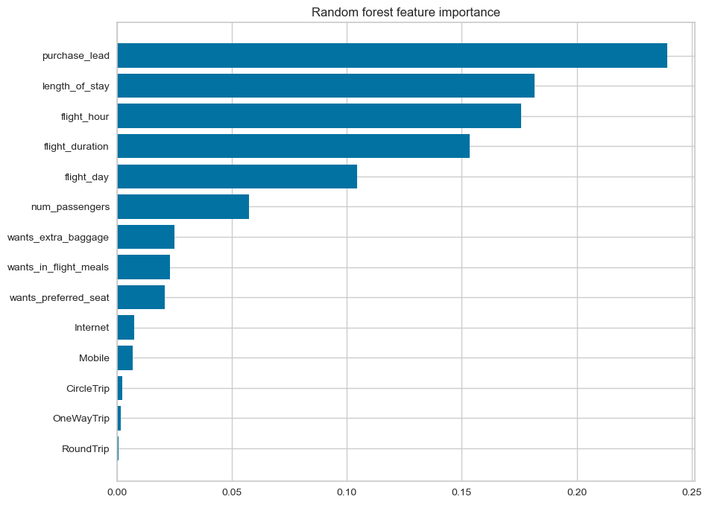
Modelling prediction
Recall Rate
62%
Precision score
61%
Accuracy Score
63%
Chance of predicting true successful bookings.
66% Chance of predicting true incomplete bookings correctly.
Will be predicted as actually completed bookings out of all successfully completed bookings.
Accuracy of the model predicting successful or incomplete booking
We are concerned with not predicting the successful bookings correctly. Imbalance dataset drives higher accuracy but it does not accurately predict the successful bookings. Dataset was balanced with 8k labelled as incomplete bookings and 7k as complete bookings.
Top features that can drive successful flight bookings.

